Slide 1

Complex
Procedural
Terrains
Zhimin Zhao
11/23/2015

Slide 2
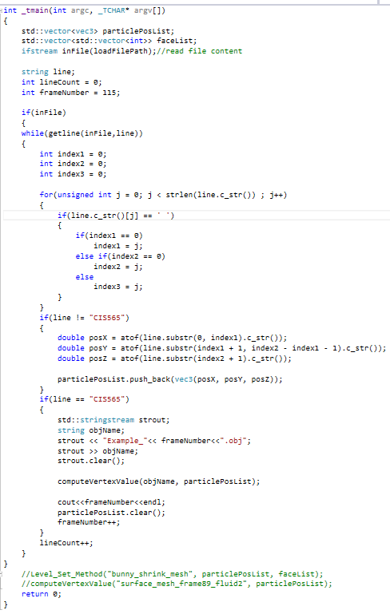

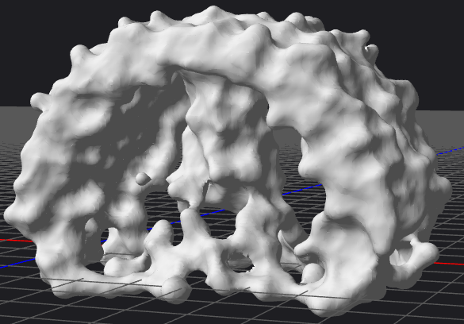

Milestone 1
1. marching cubes adapted from (http://paulbourke.net/geometry/polygonise/)
2. Lambert shader (Not completed)
rendered to .obj
3

Slide 3
Problem
1. confusion about the mesh construction procedure
2. do not know where to use the GPU (it should be in mesh construction part)
3

Slide 4
Milestone 2
1. Make the lambert shader to work well in mesh rendering
2. Sweep across the mesh construction procedure
3. Figure out where to use the GPU accelaration in data processing
4. Display a plane terrain and then add various noises
3

Slide 5

THANK U

